Slide 1
Forecasting Chicago
Home Prices
Oleksiy Anokhin, Chris Reimann, Kyla Ronellenfitsch, Mike Thompson
Time Series Analysis and Forecasting
University of Chicago
December 11, 2020

Slide 2
Agenda
EDA
Future steps
Introduction
Modeling and Results

Slide 3
Introduction
Real estate prices are of great interest to current and prospective property owners, lenders and government.
Understanding evolving trends in price is extremely valuable, especially in a competitive, yet highly seasonal market like Chicago.
In this project, we forecast median home sale prices in the City of Chicago.

Slide 4







Data Sources
Zillow (primary)
Feb 2008 – Dec 2019
143 observations
Complete
Google Trends
“Homes for Sale”, “Realtor”
Feb 2008 – Jan 2020
143 observations
Complete
S&P/Case-Shiller
Home Price Index
Feb 2008 – Jan 2020
143 observations
Complete
Labor Force
Feb 2008 – Jan 2020
143 observations
Complete
Mortgage
Feb 2008 – Jan 2020
143 observations
Complete
Dow Jones
“Homes for Sale”, “Realtor”
Feb 2008 – Jan 2020
143 observations
Complete
Consumer Price Index
Feb 2008 – Jan 2020
143 observations
Complete
Notes:
Zillow: 12 years of monthly observations. Starts right before housing crisis and ends Dec 2019.
Other Data: Don't talk about this, just say it's used in VAR model.

Slide 5
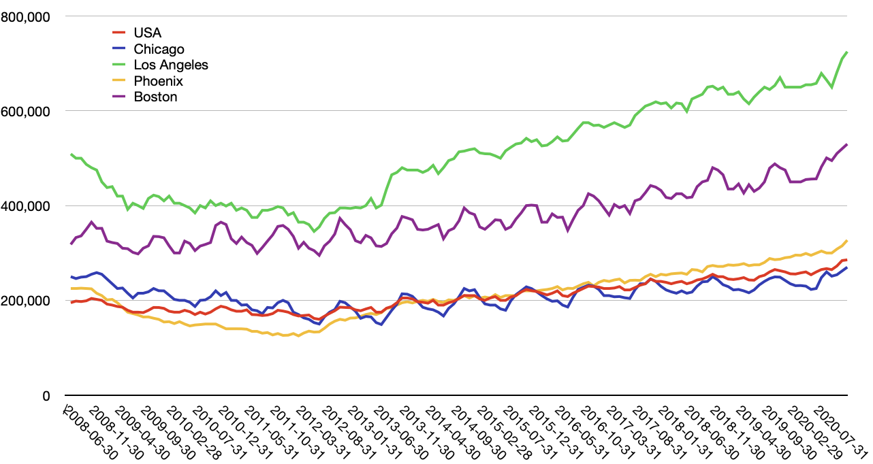
Chicago vs US cities
Like other cities with cold-climates, Chicago shows significant seasonal volatility.
Notes:
Chicago - Blue. Pretty close to the National average, but with seasonality.
Northern cities show seasonality

Slide 6
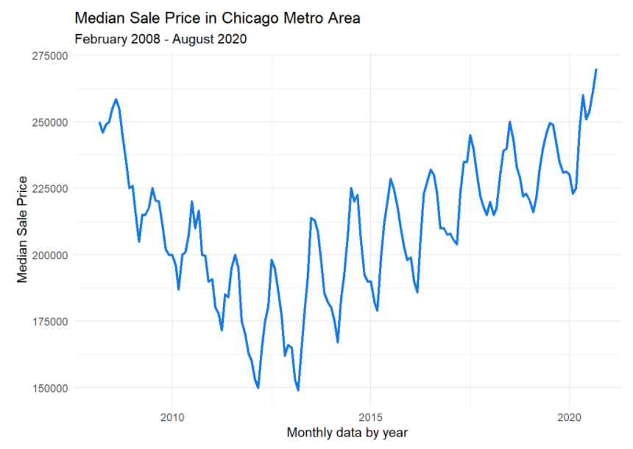
Exploratory Data Analysis
Negative trend 2008 – 2013
Positive trend 2013 – present
Additive seasonality
COVID period
(post Dec 2019) omitted from analysis
Notes:
Non-stationary
Unusual high seasonality
Two trends – down and up
The same magnitude

Slide 7
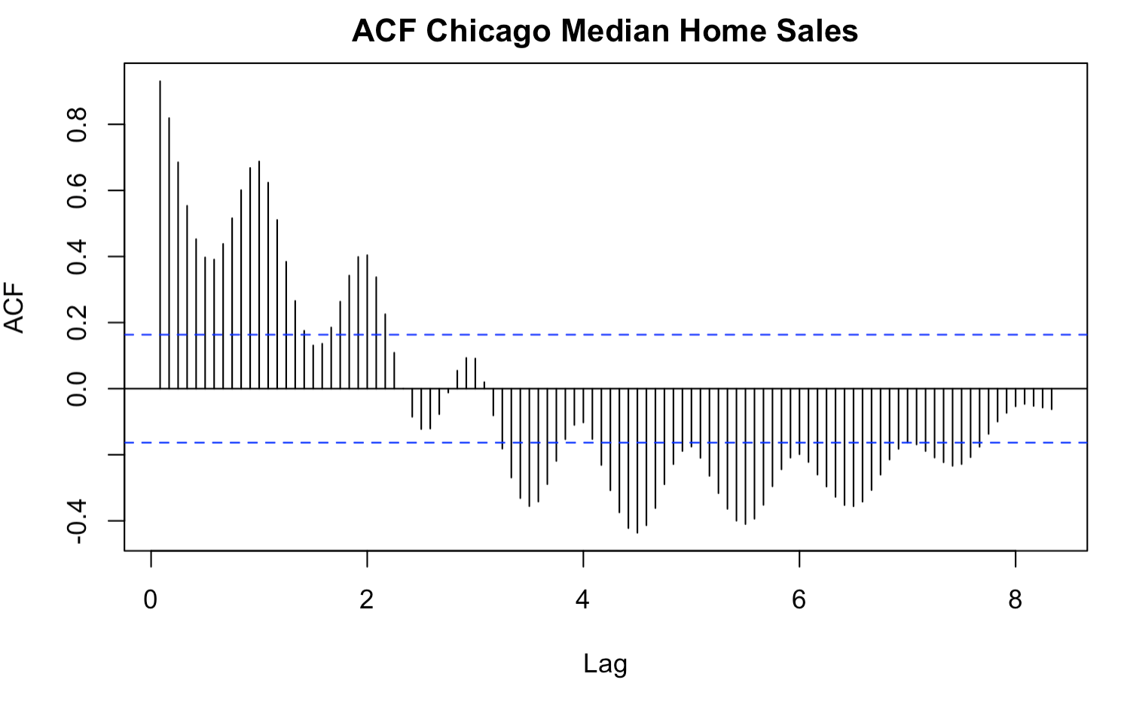
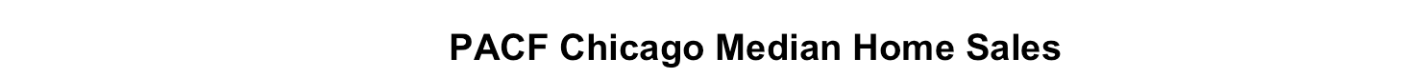
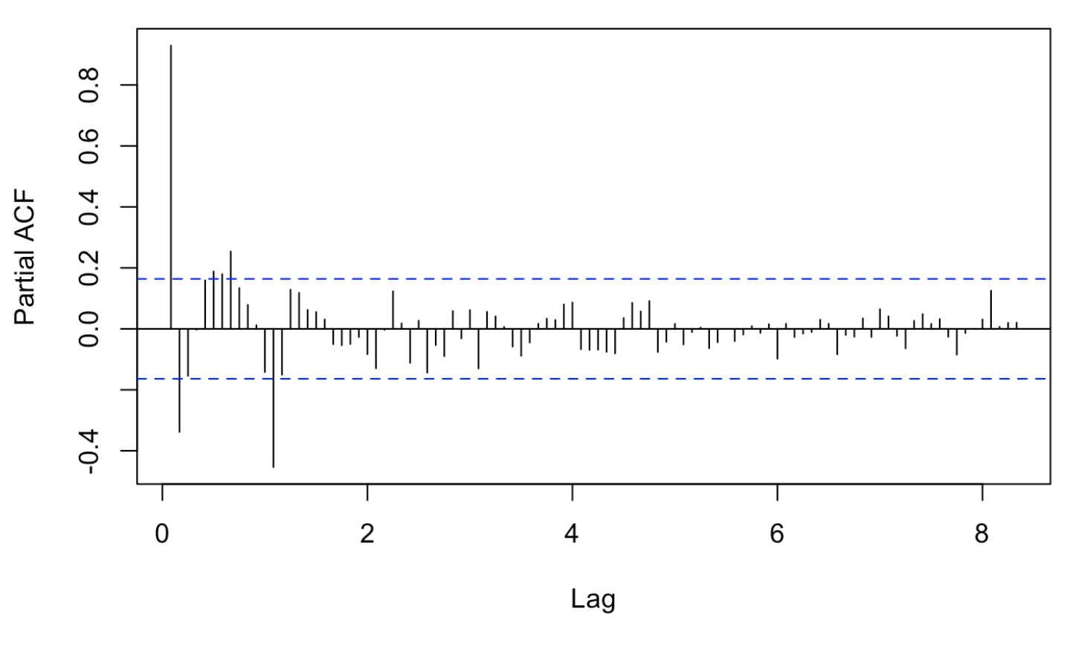
ACF & PACF 100 Lags
Slow decay indicates trend
Peaks at lag 12 show annual seasonality
Decay indicates Moving Average
Notes:
Slow decay of acf and pacf indicates both auto regression and moving average

Slide 8
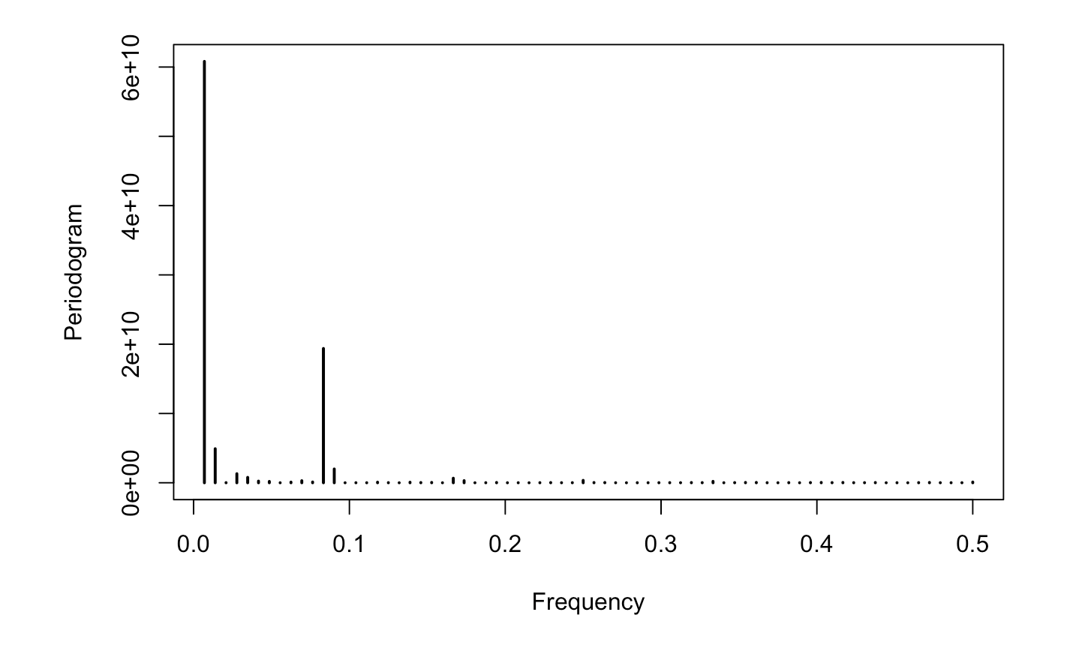
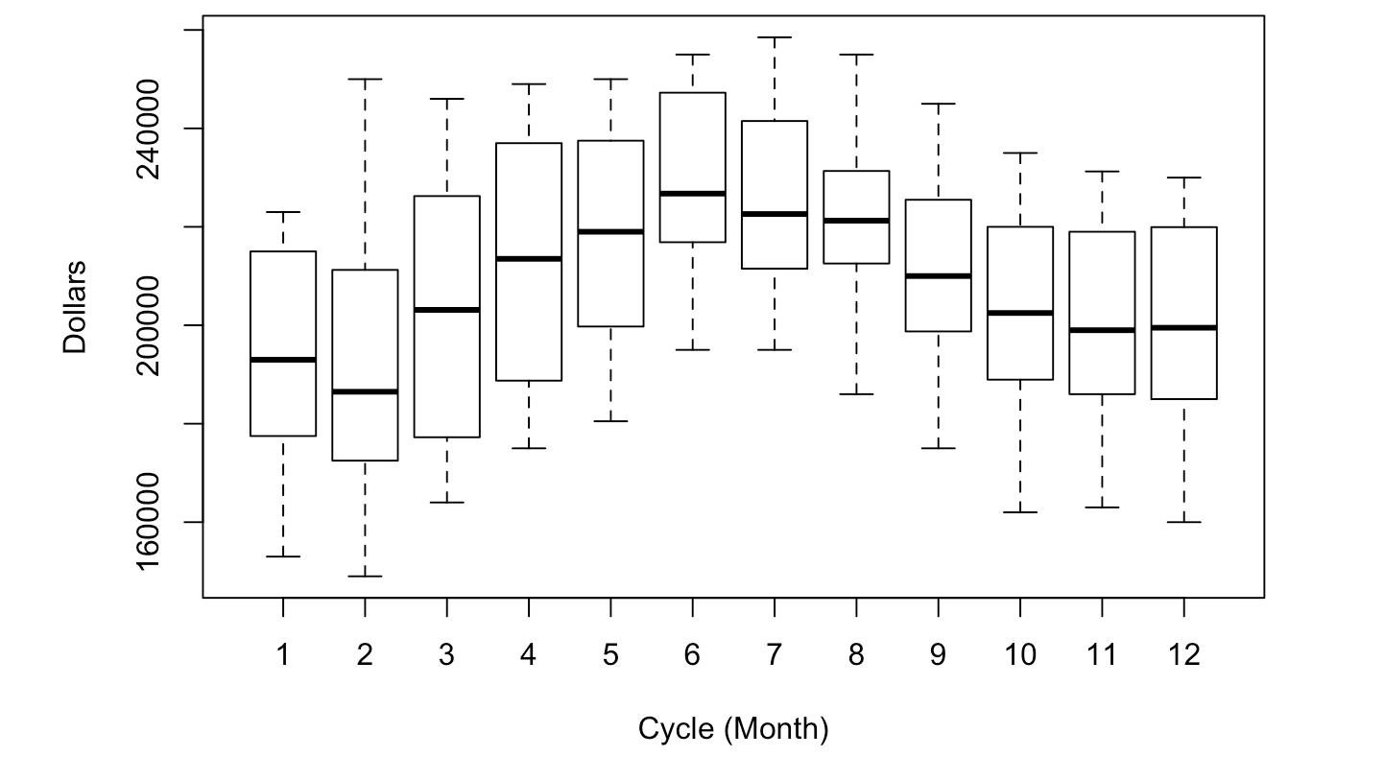
Seasonality
There is one dominating seasonal trend: annual
Median price peaks during the summer months
Range is narrower in summer months than in rest of year

Slide 9
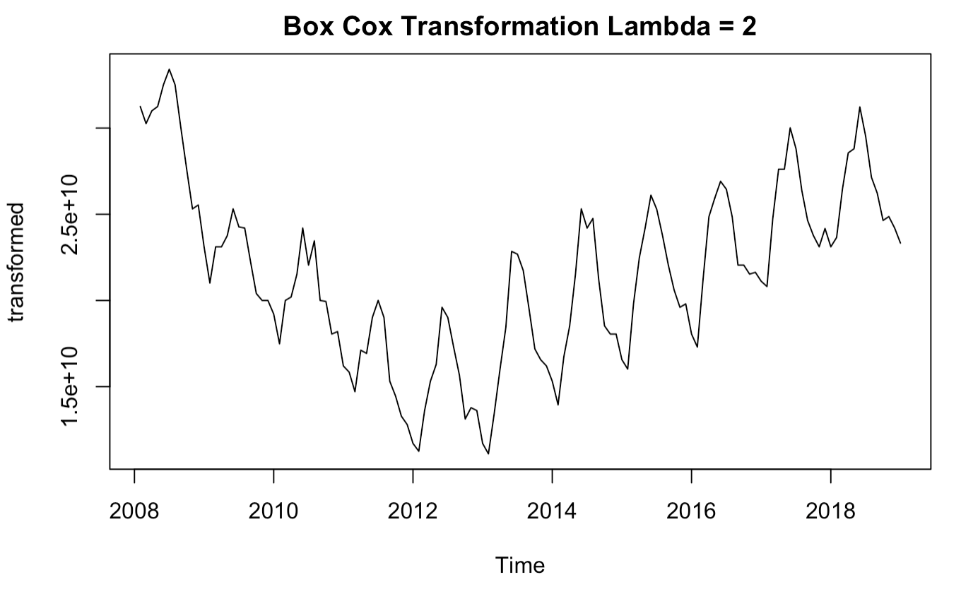
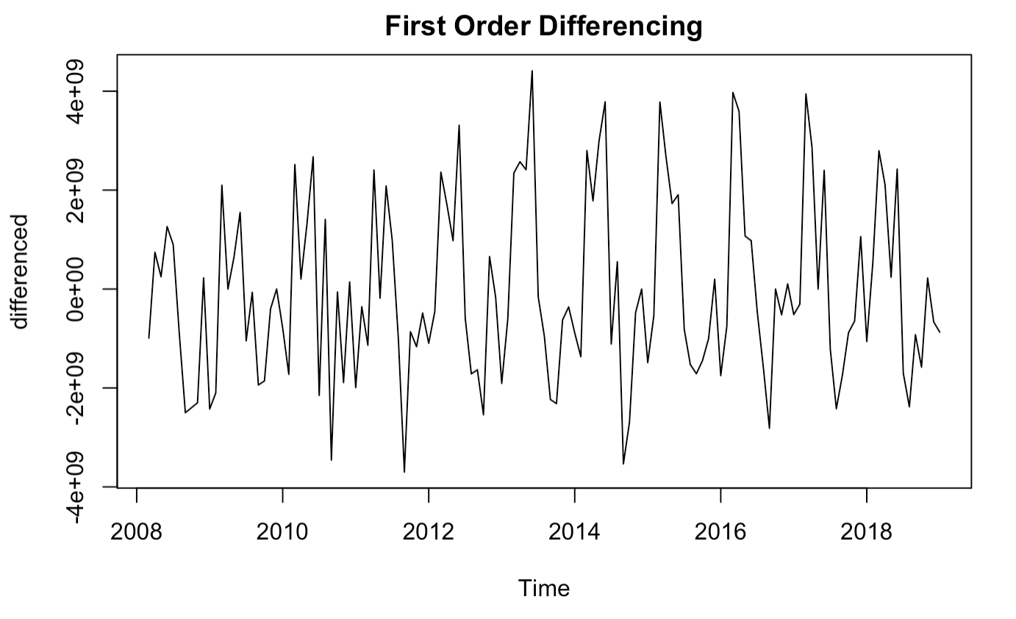
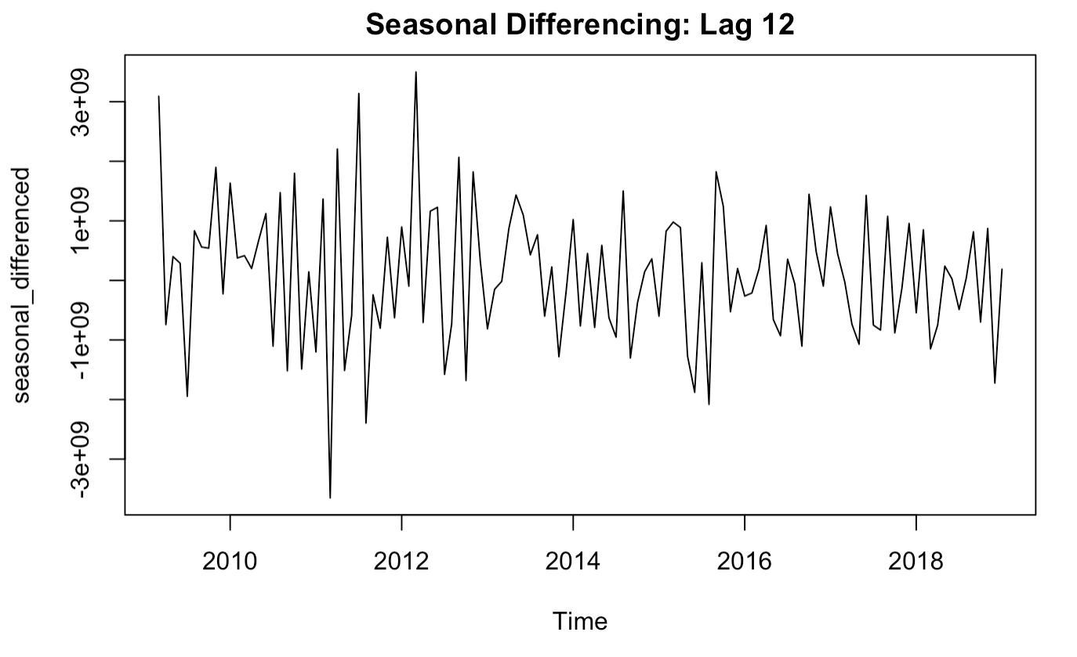
De-Trending
Detrending requires Box Cox transformation (lambda=2), first-order differencing and seasonal differencing

Slide 10
Model Selection
Exponential Smoothing
sARIMA
Regression with ARIMA errors
Vector Autoregression (VAR)

Slide 11
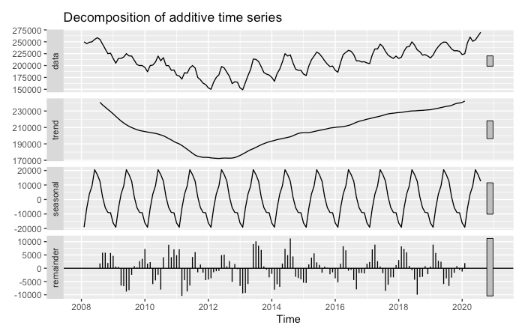
Exponential Smoothing Unaltered Data – Initial Impressions
Trend: Clear trend with a decrease during the housing recession, then additive increase thereafter.
Seasonality: Appears to be additive as well.
Remainder: Some clear seasonal autocorrelation left.

Slide 12
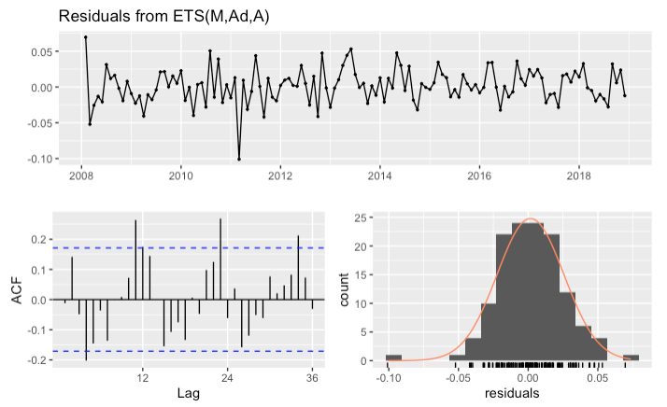
Exponential Smoothing ETS Auto-Generated Model
Auto-Generated
ETS(M, Ad, A)
alpha: 0.8893
beta: 5e-04
gamma: 1e-04
phi: 0.9611
Remaining autocorrelation in residuals (Ljung-Box p=4.775e-12)
Conclusion: automatically selected model not appropriate, need for manual adjustments
Notes:
The ETS function has returned a Multiplicative smoothing parameter model, with very low trend and seasonal effects. This is very surprising based on our initial observations of the data.
Based on the examination of the residuals, this is clearly not a good model. According to the Ljung-Box test, the residuals still have serial correlation. Also, it’s clear from the ACF chart the residual correlation is seasonal in nature.
We need to manually change the model parameters.

Slide 13
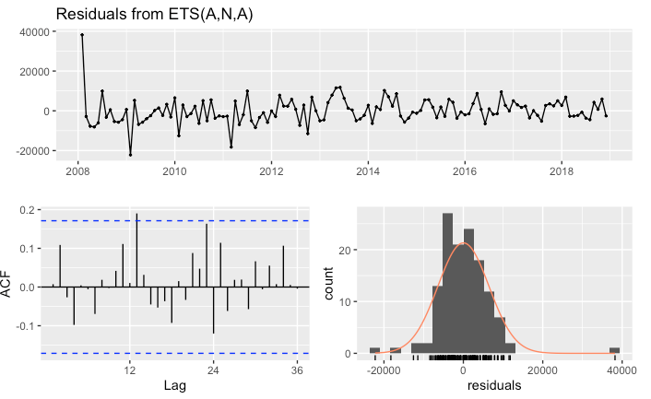
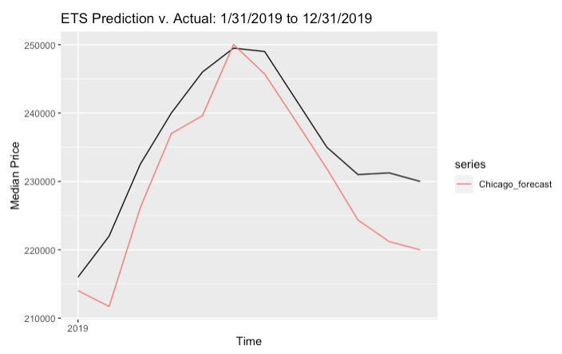
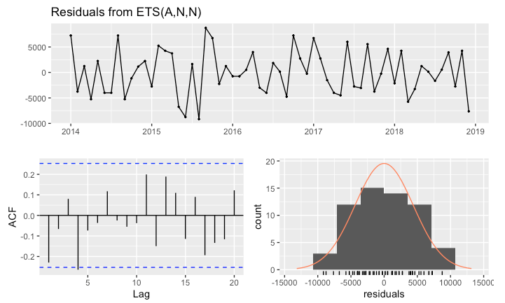
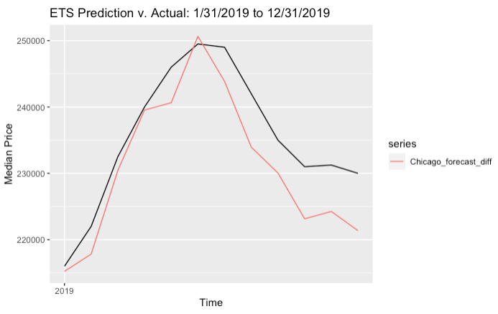
Exponential Smoothing
ETS Manual Models
ETS (A,N,A)
Original Data
RMSE: 6296
MAE: 5399
Ljung-Box p=0.09
ETS (A,N,N)
Differenced, Post 2014 Data
RMSE: 5428
MAE: 4634
Ljung-Box p=0.08
Notes:
Based on our initial observation, we are set the ETS model to an additive model with seasonality.
After various iterations, we arrived at the following parameters, which seem to work well.
For further examination, we manipulated the data provided to the ETS model. In this example, we use 1-degree differencing and seasonal differencing. We also only use housing prices after the recession.
This results in a very simple and uninteresting model. But, there is no serial correlation and the residuals look good. We will now compare the two models predictions.

Slide 14
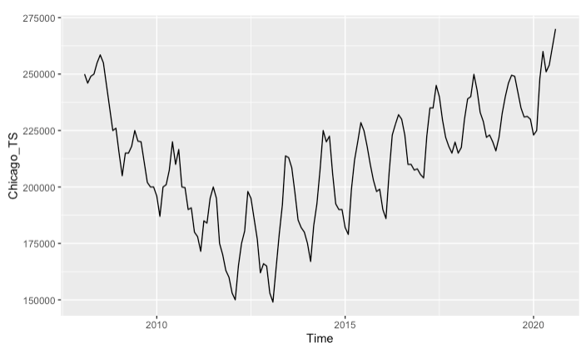
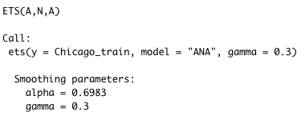
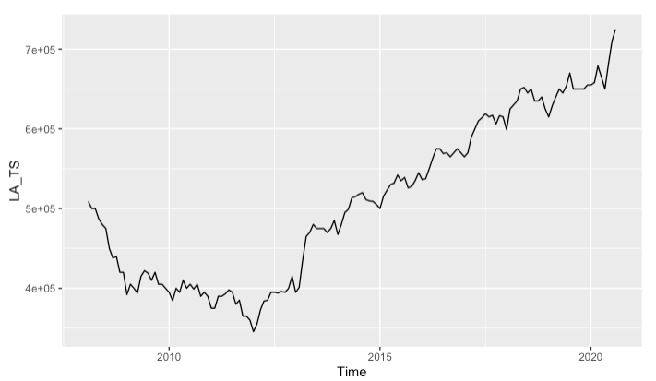
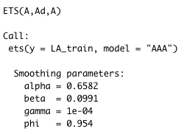
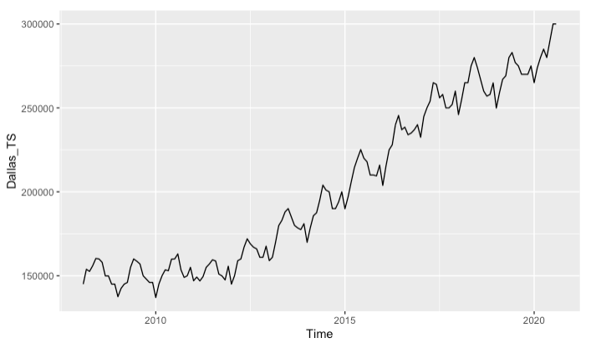
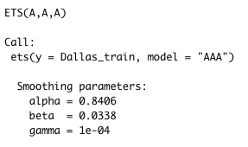
Exponential Smoothing City Comparison
Chicago
A benefit of exponential smoothing is how interpretable the model parameters are. As such, we provide a comparison of best models for
Chicago, Dallas and Los Angeles (constrained to Additive Only).
L.A.
Market Descriptions
Chicago: The alpha value indicates more weight to older values. No increase or decrease in trend. Very seasonal. Market Description: Stable market – Buy in the winter sell in the summer.
Los Angeles: The alpha value indicates more weight to older values. The beta value also indicates a slightly increasing slope. There is also a little bit of dampening. Market Description: Stable market with houses increasing in value, but increase is slowing down.
Dallas
Dallas: The alpha value indicates more weight to newer values. The beta value also indicates a slightly increasing slope. There is also a little bit of dampening. Market Description: Less stable market with houses increasing in value and not appearing to slow.
Notes:
Extra analysis:
Good things about ets models is the parameters are very interpretable.
Chicago ets paramters: alpha around .6 similar to LA – so longer memory, whereas Dallas is alpha .8, shorter memory
Chicago has largest gamma parameter, which makes sense because of it’s seasonality.
Unfortunately for Chicago homeowners, smallest beta value (not an increasing slope, like LA and Dallas)

Slide 15
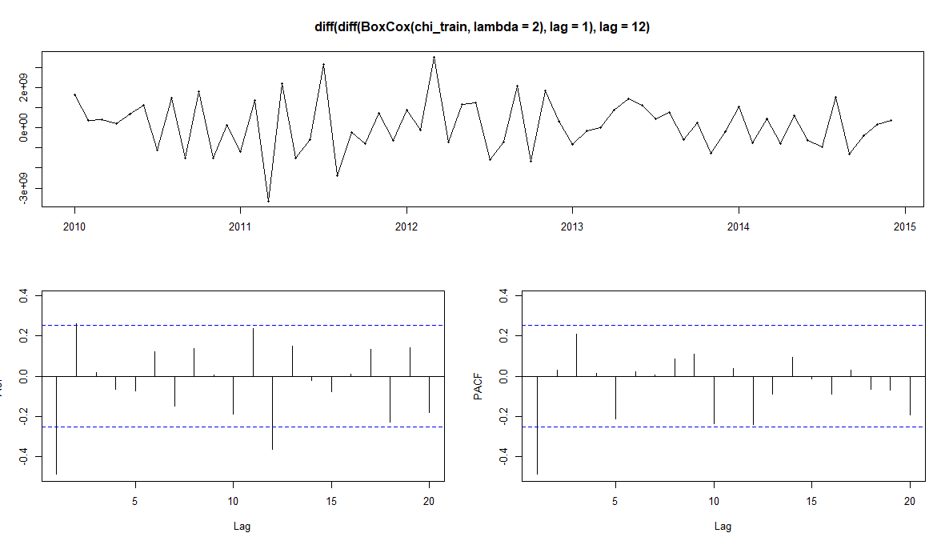
sARIMA – Model Exploration
Transformed data based on EDA
ACF spikes at lags 1, 2, and 12
PACF spike at lag 1. Lags 3, 10, and 12 also close to threshold
Use EACF to find candidates for p and q in ARIMA(p,1,q)(P,1,Q)[12], where p,q<=3 and P,Q<=1
Pick candidates that perform best on AICc and RMSE during 2015

Slide 16
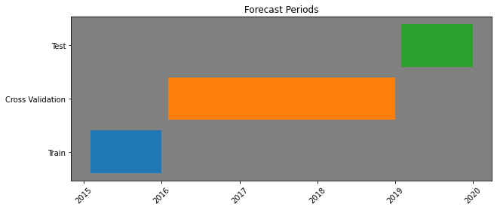
sARIMA – Cross Validation Results
Model | AICc | MAE '16-'18 | RMSE ‘16-’18
ARIMA(0,1,2)(0,1,1)[12] | 2,606 | 4,640 | 5,587
ARIMA(1,1,2)(0,1,1)[12] | 2,603 | 4,520 | 5,594
ARIMA(2,1,2)(0,1,1)[12] | 2,602 | 4,085 | 4,975
ARIMA(1,1,3)(0,1,1)[12] | 2,605 | 4,694 | 5,881
ARIMA(3,1,2)(0,1,1)[12] | 2,604 | 3,766 | 4,740

Slide 17
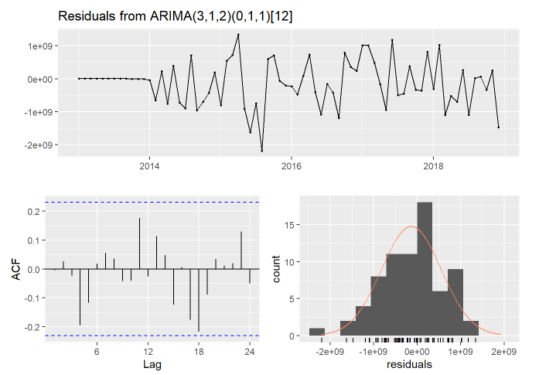
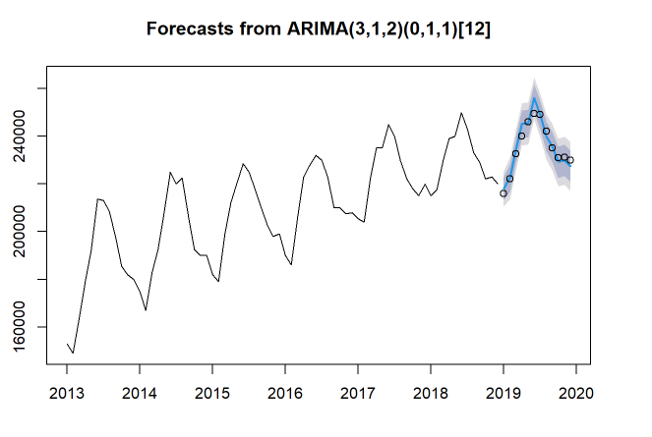
sARIMA – Test Set Results

Slide 18
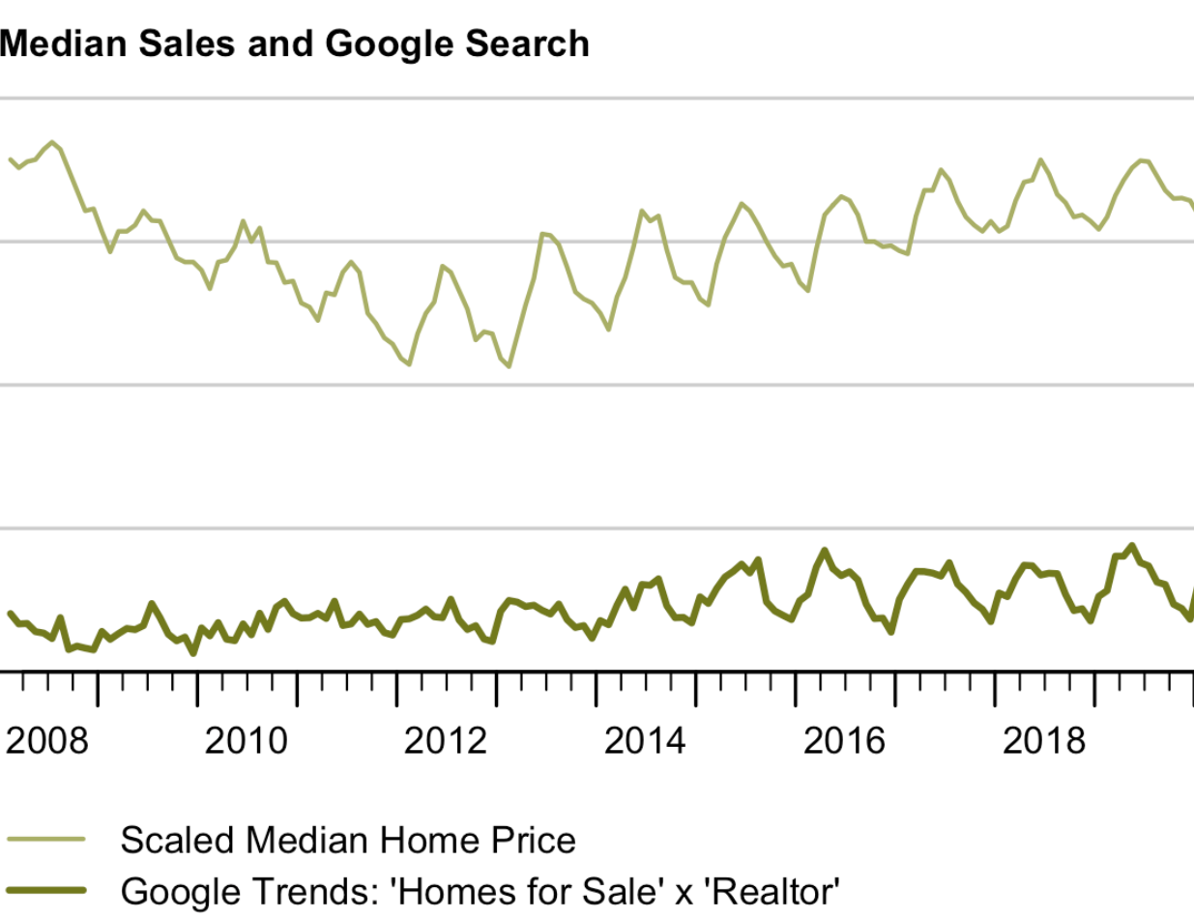
Regression with ARIMA Errors
Google Trends Search Terms “Homes for Sale” x “Realtor” as predictor (correlation = 0.4)
2012+ for training with sliding window cross validation
Google Trends Box Cox Transformation with Lambda = 0.2

Slide 19
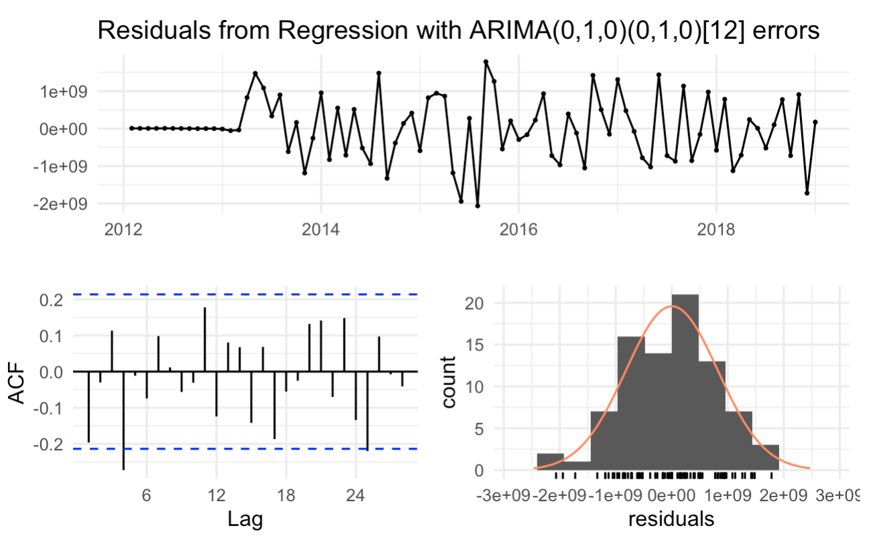
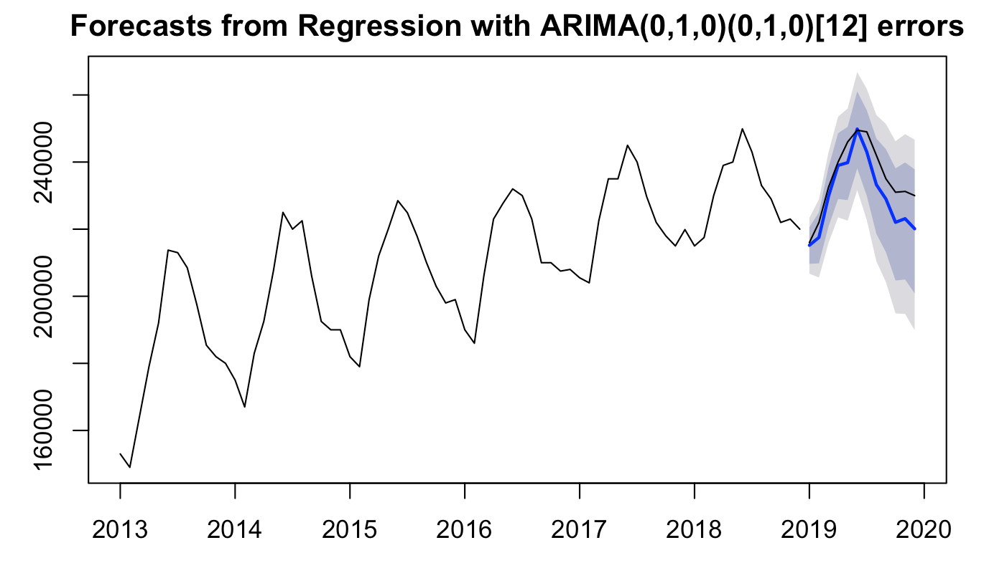
Regression with ARIMA Errors
No remaining autocorrelation
Ljung-Box Text p=0.06
RMSE: 6188
MAE: 5267

Slide 20
VAR model
VAR models are used for multivariate time series
Our options for the model together with Average Median Price:
Unemployment rate
Average US Mortgage Rate
Consumer Price Index
Labor Force
Dow Jones Industrial Average Index
S&P/Case Schiller Home Price Index
Notes:
Variable is a linear function of past lags and past lags of other variables

Slide 21
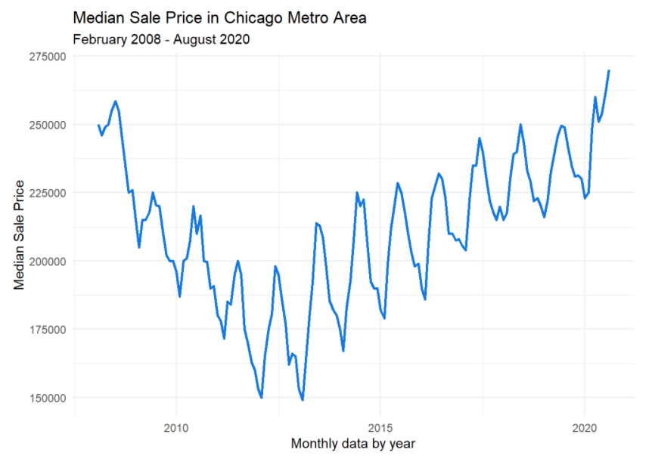
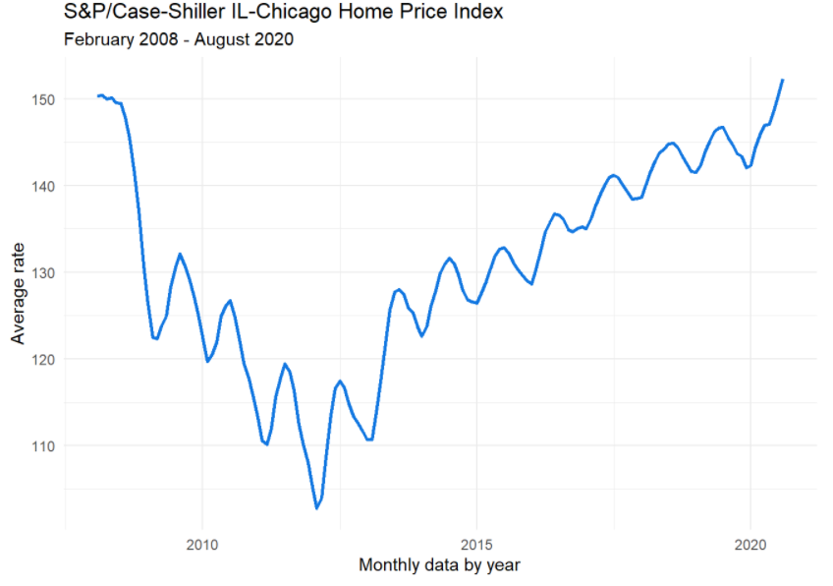
VAR model
Average Median Price & S&P/Case Schiller Home Price Index (correlation = 0.9)

Slide 22
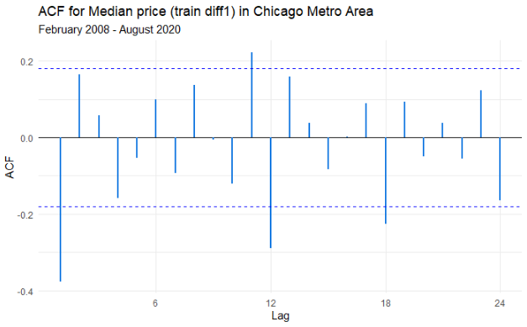
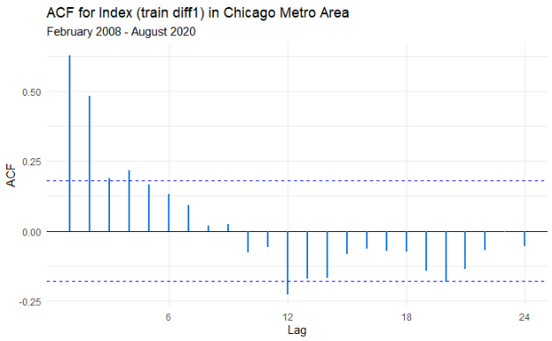
VAR model
Both variables are non-stationary
Stationary after 1st order differencing (trend and seasonality)
P-values: small for ADF test and large for KPSS test
Correlation: dropped from 0.9 to 0.11
Recommended: VAR(6) based on AIC score
Other options: VAR(5), VAR(4), VAR(1)

Slide 23
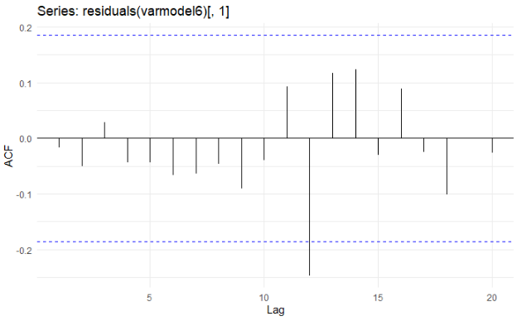
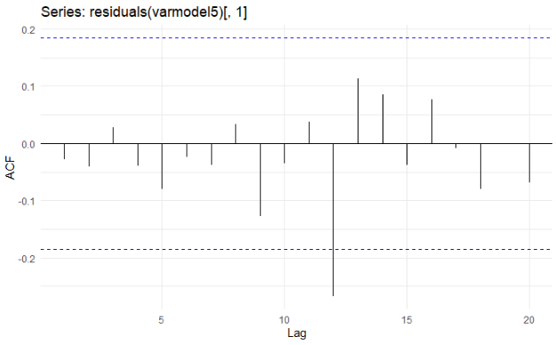
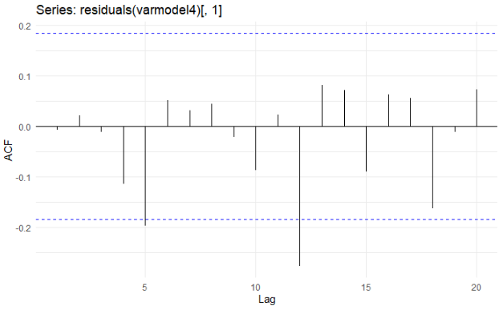
Model of choice – VAR(5)
Model | P-value | RMSE | MAE
Var(6) | 0.03672 | 4061.737 | 3305.597
Var(5) | 0.05457 | 4207.025 | 3337.969
Var(4) | 0.05343 | 4650.828 | 3802.752
Notes:
The null hypothesis of no serial correlation in the residuals is rejected for both a VAR (6) (i.e., p-value<0.05) – slides 67-68 of the Week 7 presentation by Professor Abado.

Slide 24
Model Performance: 2019
The VAR model has the lowest error overall, followed closely by sARIMA.
However, sARIMA is more parsimonious.

Slide 25
Next Steps
Try models on other markets, particularly those with less seasonality to assess performance
Build more complex VAR models (3+ predictors)
Identify additional predictors

Slide 26





Our Team
Chris Reimann
Kyla Ronellenfitsch​
Oleksiy Anokhin​
Mike Thompson
Notes:
Each group member was an equal contributor to the final project. We each completed EDA, experimented with different models, and contributed to the final report. Additionally, we were individually responsible for inclusion of the following models: · Chris: Exponential Smoothing · Mike: sARIMA · Kyla: Regression with ARIMA errors · Oleksiy: VAR

Slide 27
Q & A

Slide 28
Sources
GitHub repository

